Slide 1
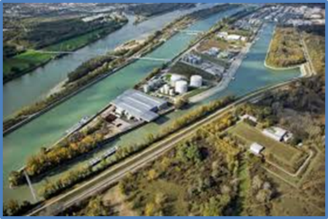
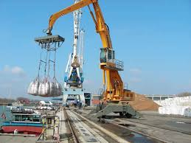
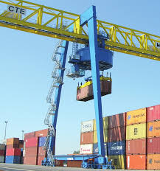
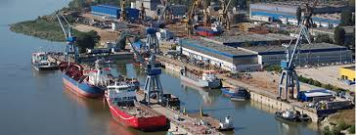
DANUBE PORTS NETWORK
DPN OFFICIAL LAUNCH EVENT
10 April 2019, Vienna

Slide 2
BUILDING & consolidating the Danube ports network KEY INITIATIVES & ACTIVITIES PILOT ACTION phase (June 2018-June2019)

Slide 3
DANUBE PORTS NETWORK (DPN)
DANUBE PORTS COOPERATION WITHIN A COMPETITIVE ENVIRONMENT
Key driver: necessity of transformation in the Danube Region’s port sector
DPN has the potential to be an excellent mechanism for economic, environmental and social transformation in the Danube Region’s port sector.
With good management, strategic guidance, good will and determination, DPN shall achieve more than single port organizations’ approaches.

Slide 4
DPN | STRENGHTS
DPN emerging as a new actor in the Danube Region port governance system.
A stronger voice & greater capacity
Project-based access to financial support
Knowledge creation & dissemination
Enhanced reach out to key stakeholders
A well - coordinated cooperation platform

Slide 5
DPN | Key thematic focus
DPN emerging as a new actor in the Danube Region port governance system.
Sustainable port development & operations
Port digitalisation, RTD & Innovation
Port connectivity & hinterland connections (multi-intermodal)
Port labour – education and training
Environment, Energy, Climate Change

Slide 6
DPN | activities & core services
SC1
SC2
SC3

Slide 7
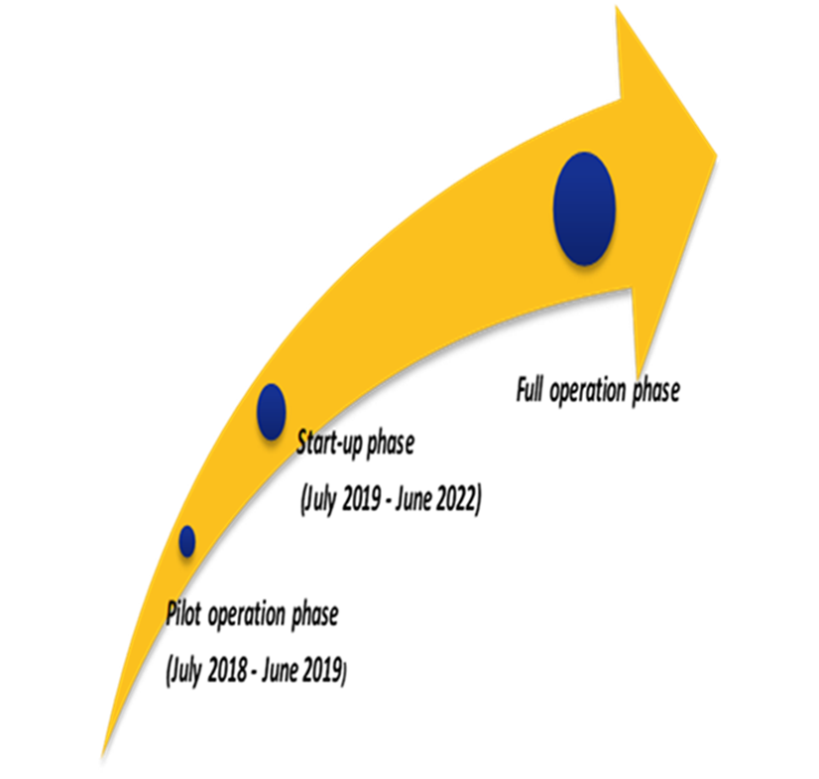
Main focus of DPN work
Pilot action phase
Building & consolidating the capacity of the network
Rolling out a defined set of activities
Managing & sustaining the network

Slide 8
key milestones DPN’s consolidation phase
DPN Strategic Partnership formalised (7 Letter of Commitment signed )
DPN governance structure operationalised
DPN Advisory Group elected
DPN Technical Secretariat’s set up
DPN Financing Model and a Business Plan elaborated
Concrete steps towards awareness creation :
Introductory meetings with strategic stakeholders: professional organisation (EFIP), EU Policy makers (EC Services: DG MOVE, DG REGIO), EU Funding agencies: INEA, DTP etc.)
10 April, 2019, Vienna -- official launch event of DPN
11 April 2019, Vienna -- first DPN know-how transfer event dedicated to port digitalisation

Slide 9
Main focus of DPN work
MANAGING THE TRANSITION
Ensuring institutional & financial sustainability of the DPN
Delivering tangible and practical results.
Planning for the longer term

Slide 10
Delivering successful projects – moving from plan to action
KEEPING TO THE TASK
Initiation, development & implementation of common interest projects & activities
Strengthening DPN Secretariat human resource capability
Planning for the future:
Long-term resourcing
Strategic planning, including a indicators and measures to track progress and impact
Securing strong engagement of partners

Slide 11
EEA and Norway Grants Fund for Regional Cooperation (2014 - 2021)
DPN | POTENTIAL PROJECT
Sustainable management and operations of Danube and Black Sea Ports – Phase I
Project Objectives
To develop a permanent Environmental Management System (EMS) in several Danube ports, as well as at least two Black Sea ports (public port administrations and private port operators);
To integrate the EMS into the organization´s Management Information System (MIS) as element of the Business Strategy;
To reduce the negative environmental impact of port activities & improve living and working conditions;
To strengthen cooperation between public & private entities active in the port area in order to include the port stakeholders into the port´s environmental improvement activities, etc.
1st Call for proposals - CONCEPT NOTE PHASE

Slide 12
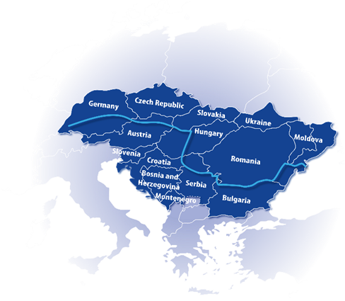
Integrating Danube Region into Smart & Sustainable Multi-modal & Intermodal Transport Chains – DIONYSUS
DPN | POTENTIAL PROJECT PARTNER
Project objectives:
To integrate the Danube Region into smart and sustainable, multi-& intermodal transport chains of cargo and passenger flows;
To align port investment needs, multi-modal access infrastructure and transport connections to port hinterlands with transport infrastructure and regional development plans;
To enable and reinforce the impact and capitalisation of the Danube Ports Network (DPN).
INTERREG/DTP – 3rd Call – Stage 1 Project Start Q1/2020 if selected

Slide 13
that should help to keep the Network on track when the going gets tough…
DPN |GOLDEN RULES
Golden rule 1 - BUILD ON SHARED VALUES
because successful collaborations are values-driven
Golden rule 2 - BE CREATIVE & FLEXIBLE
because every DPN Partner is unique
Golden rule 3 - BE COURAGEOUS
because every partnership & collaboration involves efforts & risks

Slide 14
Thank you for your attention!
Good Luck to us in making the DPN work successful !
Janeta TOMA
DPN Technical Secretariat
(hosted by Pro Danube International)
Handelskai 265
A-1020 Vienna/Austria
Tel: +43 (0) 699 1929 5036
Fax: +43 (0) 1 890 66 47-99
toma@prodanube.eu
office@danubeports.eu
www.danubeports.eu

